Slide 1

Wissen Smart Seat Allocation System
Hybrid workplace automation platform — Tech stack: Next.js | Supabase (Postgres) | Tailwind CSS

Slide 2





Problem Statement
Capacity Mismatch
Manual Conflicts
Cross-batch Complexity
No Central Control
Hybrid office with 50 seats vs 80 employees in rotating batches — resource contention.
Manual bookings create seat conflicts and admin overhead.
Cross-batch bookings and temporary floaters introduce allocation ambiguity.
Lack of centralized admin governance for rules, holidays and locking.

Slide 3

Solution Overview
Automated Allocation
Rule-driven engine assigns seats without manual selection.
Batch Scheduling
Batch-aware logic ensures fair rotation and isolation between groups.
Floater Management
Handles floater seats and temporary floaters when seats are released.
Policy Awareness
Holiday-aware rules and time-based booking restrictions (post 3 PM block).

Slide 4





Unique Selling Points (USP)
Auto Allocation
Dynamic State Conversion
Real-time Visualization
Intelligent assignments — users don't choose seats; system optimizes placement.
Batch-aware live seat map for employees and admins.
Regular → Temp Floater conversion when seats are released or reassigned.
Admin Governance
Rule-Driven Engine
Configurable rules: holidays, locks, booking windows, and batch policies.
All decisions derived from auditable business rules — deterministic behavior.

Slide 5

System Architecture
User
Next.js Frontend
Supabase Auth
Postgres DB
Stateless Next.js UI connects to Supabase for auth and realtime events; Postgres stores allocations, holidays and settings. Designed for horizontal scaling and auditability.

Slide 6

Technologies & Tools
Frontend: Next.js (App Router) — SSR/ISR + client interactivity
Styling: Tailwind CSS — consistent, utility-first design
Backend & DB: Supabase (PostgreSQL) — managed Postgres with realtime
Auth: Supabase Auth — secure sessions, OAuth support
Deployment: Vercel — edge-first, fast builds
Version Control: GitHub — CI/CD pipelines

Slide 7
Employee Module
Secure Login
Supabase Auth + session tokens; role-based access for users.
Auto Allocation
Requests routed to allocation engine — returns deterministic seat id.
Cross-Batch Floater Booking
Floater rules allow safe cross-batch occupancy without conflicts.
Seat Release & Week View
Release seat → becomes temp floater; week overview with allocation stats.
Profile Management
Preferences, batch assignment, and notification settings.

Slide 8

Admin Module
Employee Management
Create, edit batches, roles and overrides.
Holiday Management
Global and site-specific holiday rules that alter allocation logic.
Seat Locking
Lock seats for special use; locking respected by allocation engine.
Booking Time Config
Define booking windows (e.g., block after 3 PM) and override rules.
Monitoring
Allocation logs, audit trail, and batch-wise visibility.

Slide 9
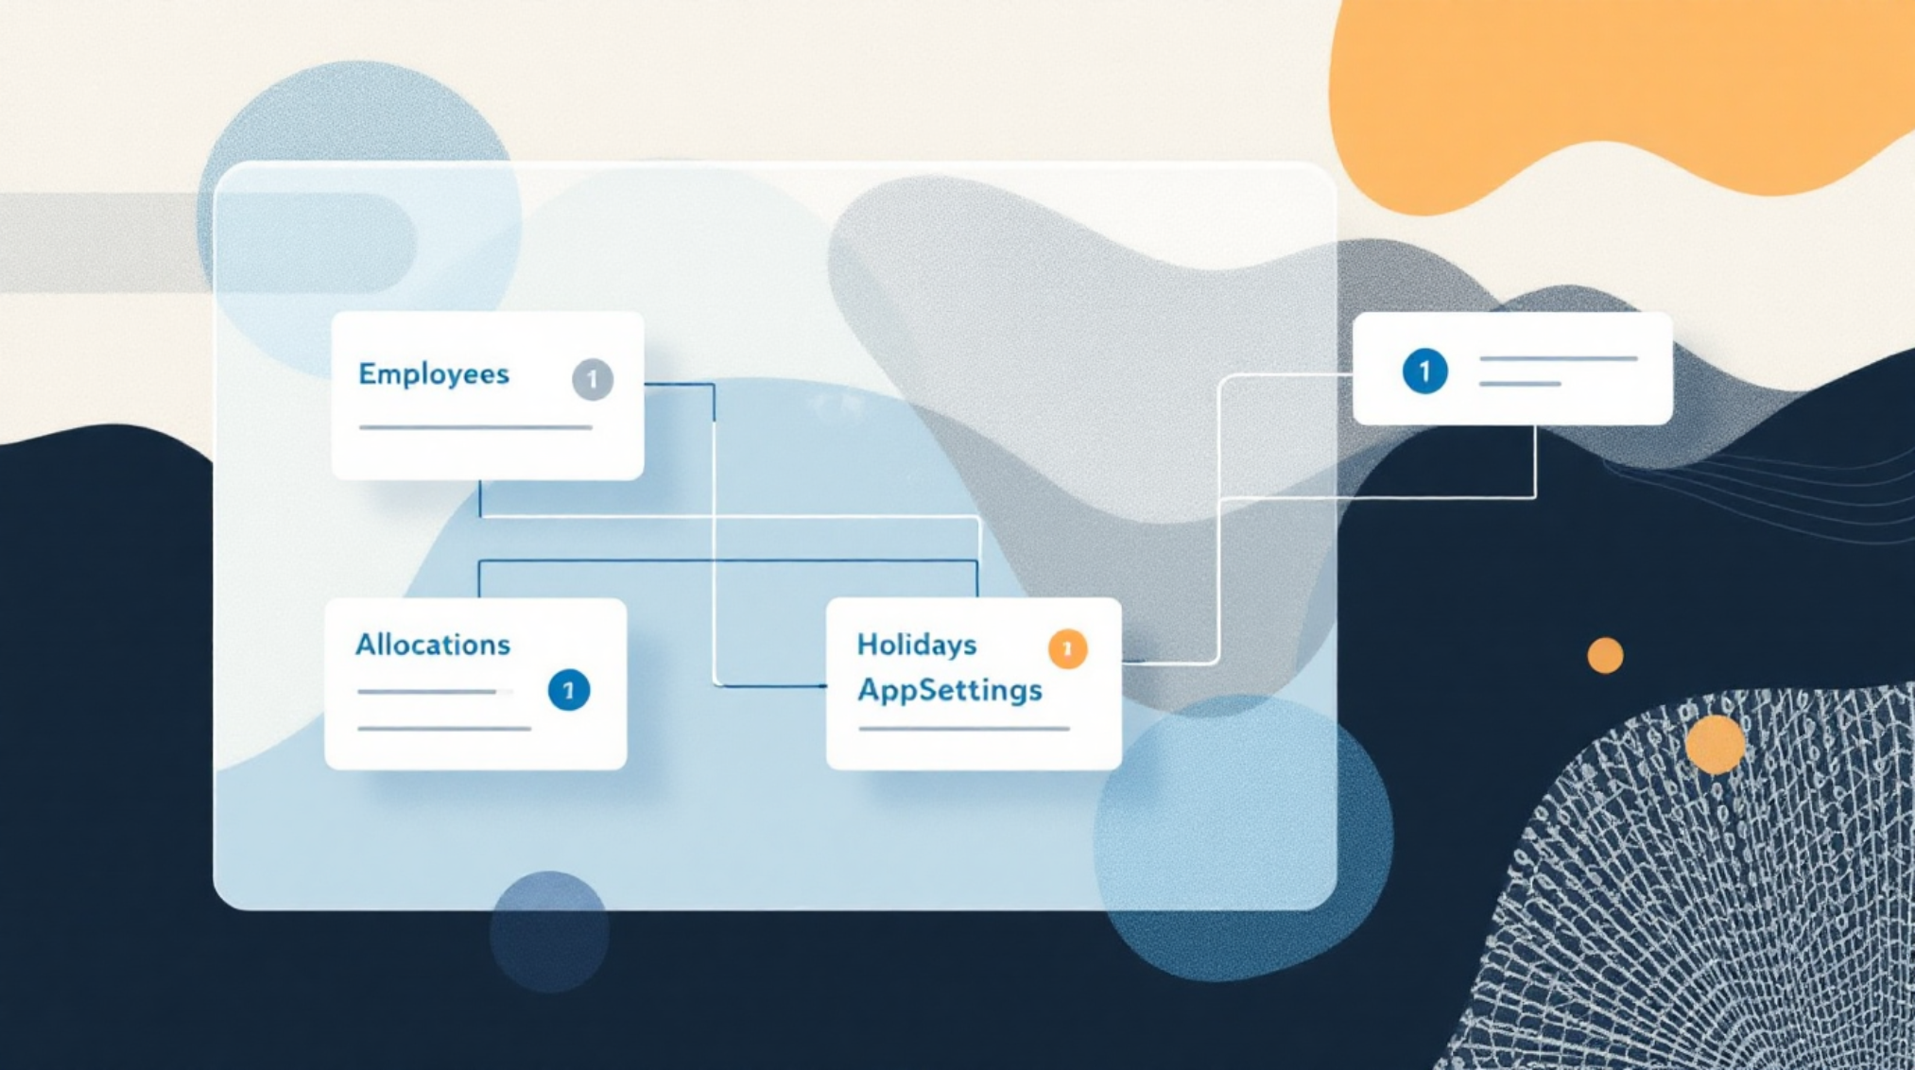
Database & Business Logic
Core Tables
Employees, Allocations, Holidays, AppSettings — normalized, indexed for queries.
Key Business Rules
40 regular seats, 10 floater seats
Released seats become temp floaters for same-day allocation
Booking restricted after 3 PM (configurable)
Batch rotation enforces fair seat distribution
Scalability Notes
Use DB indexes, read replicas, and Supabase realtime for scale and low-latency updates.

Slide 10

Impact & Conclusion
Enterprise-Ready
Scalable Architecture
Configurable, auditable rules make this suitable for large organisations.
Next.js + Supabase (Postgres) path supports growth and realtime needs.
Strong Engineering Fit
Demonstrates full-stack capability: secure auth, deterministic engine, and observability.
Next steps: prototype integration tests, load testing on allocation engine, and a pilot with a 100-seat office.

